Slide 1
@Input, @Output and EventEmitter (or) Components Communication

Slide 2
→To communicate from parent to child component we use @Input decorator to pass data from parent to child component
Send back data from child to parent we use @Output decorator.
The @Output emits the data using the EventEmitter method
to the parent component.
Use in components with the @Output directive to emit
custom events synchronously or asynchronously
Parent Component
@Input
Child Component
@Output

Slide 3
Parent Component
Value get updated from Child to Parent
Button
Button
Value get Updated from parent {{Value}}

Slide 4
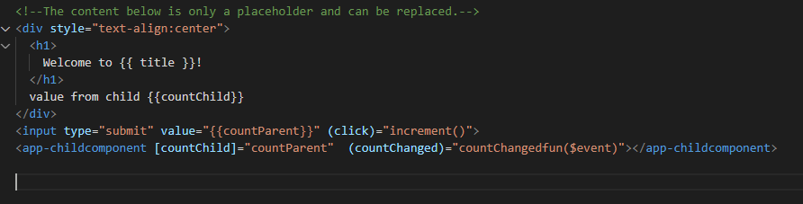
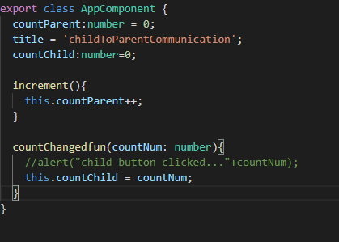

Slide 5
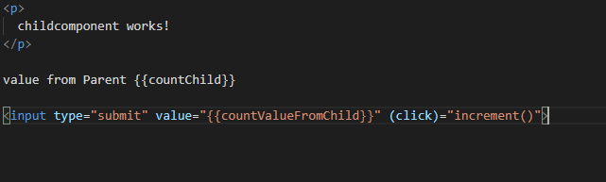
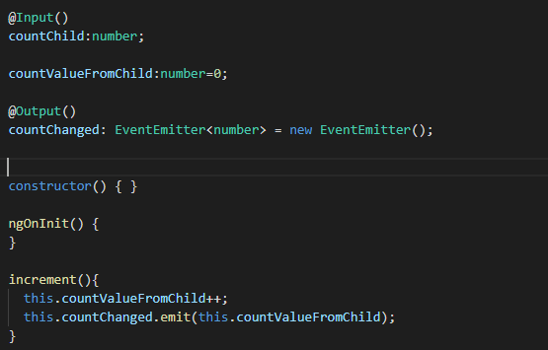

Slide 6
Practise
-----------
a)Parent component should have text fields for employeename,salary,address
b)Once we submit with details Child component should take values as json object and update in Array
c)Display all values from Array in child componet
Employee Name
Salary
Address
Employee Details
Parent Component
Submit
Name Salary Address
ABC 5000 Hyd
Child Component

